Slide 1
Apigee Products Overview
Parameswari Ettiappan

Slide 2
Agenda
Apigee Edge Overview
API services review
Developer services review
Analytics services review
Technical overview
Architectural details
Troubleshooting and issue management
Community

Slide 3
API
Application programming interface (API) is the base upon which digital business is built.
It allows app developers to create apps that can serve the needs of a specific segment of users.
API Management enables you to create, analyze, and manage APIs in a secure and scalable environment.

Slide 4
API Management
API management is the process of
creating and publishing APIs
enforcing their usage policies
controlling access
nurturing the subscriber community
collecting and analyzing usage statistics.

Slide 5
API as Cloud
API management capabilities are delivered in the cloud as a SaaS (Software as a Service) solution, or on-premises in a private cloud, or sometimes using a hybrid approach.
Build and deliver apps to meet the expectations of customers, employees, and partners, without conceding the stability, reliability, and security of back-end systems – with Apigee.

Slide 6
API products
Gateway:
servers that act as API front-end, receive API requests.
enforce throttling and security policies.
pass the calls to the back-end service.
and then pass the response back to the invoker.
Gateways often include transformation engines to orchestrate and modify the requests and responses on the fly.
They can also collect analytics data, provide caching and other functionality.

Slide 7
API products
Publishing tools:
user interface that API providers use to define the APIs and their access and usage policies, debug execution, manage API lifecycle.
Developer portal / API store:
community site for API subscribers that is typically branded by API providers and includes documentation, interactive API console to try the APIs, ability to subscribe to the APIs and manage subscription keys, and get support from the API vendor and community.
Reporting and analytics: reports on API usage and subscriber behavior that let API publisher optimize their offering.
Monetization: ability to charge money for commercial APIs.

Slide 8
Vendors
3scale
Apigee
Axway
CA Technologies
IBM
Informatica
Intel Services
MuleSoft
SOA Software
Tibco Software
Tyk Technologies
WSO2

Slide 9









The way we work and reach customers is evolving
Websites
Connected Cars
Partners
Websites
APIs
Connected Appliances
Game Consoles
Millions 1993 - 2000
Trillions 2013+
Internet TVs
Smartphones
9
Tablets
Notes:
The way we work with and reach new customers is evolving.
Just in the 90s having a website on the internet was required, in the early 2000, that website actually brought in direct revenue. Today having a website as a single external channel to reach your customers is not enough.
You need to be in many different channels. But how do you get there? How do you create the apps needed for all these channels? Through APIs and you leverage an external developer/partner community.
Some pinoneering examples of companies who have succeed in this market space are ebay, twitter, amazon and facebook. APIs are being adopted in every industry from Retail, Insurance to financial to automotive.
We are entering the API Economy era. As you may have heard many times already, to not have an API today is like not having a website in the 90s
9

Slide 10
How do you enter this API economy space?
You need a complete API strategy which addresses both API creation as well as how it is going to be consumed.
APIs in the API economy become a product and should be treated as such.

Slide 11






A complete API strategy should address API creation and consumption
Grow revenue through new channels
Deliver a differentiated customer experience
Creation
Consumption
External APIs
Partner APIs
Assets & Services
Application End Points
Assembly
Transformation
Rationalization
Internal APIs
Discovery
Composition
Deployment
11
Notes:
How do you enter this API economy space?
You need a complete API strategy which addresses both API creation as well as how it is going to be consumed.
APIs in the API economy become a product and should be treated as such.
11
Confidential

Slide 12








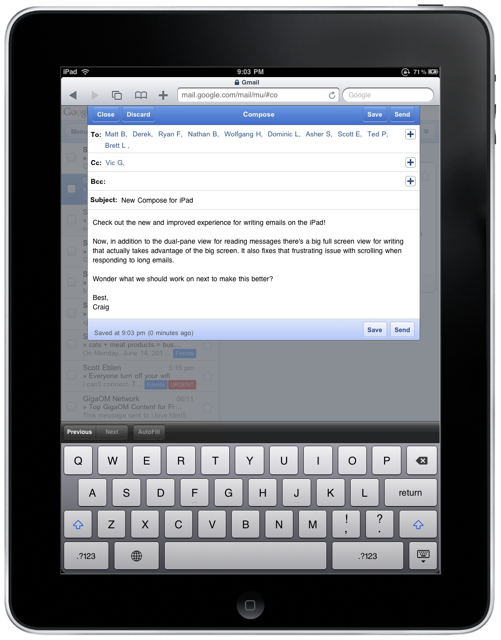




The Impact on the Enterprise
Business:
New routes to market
Reduce cost of sale
Drive brand awareness
Customize products/offerings
Increase innovation
Drive alignment with suppliers
New revenue sources
Reduce operating expenses
Customer Satisfaction
www.american.com
www.american.com

Slide 13
The Impact on the Enterprise
Business:
New routes to market
Reduce cost of sale
Drive brand awareness
Customize products/offerings
Increase innovation
Drive alignment with suppliers
New revenue sources
Reduce operating expenses
Customer Satisfaction
Technology:
New standards
Increase security risk
More platforms
Increase resources & skills
www.american.com
www.american.com

Slide 14







Apps, APIs and API Mgmt…
Apps
Apps = Customer facing systems of engagement (Ex: mobile app, web app, etc)
Customer
APIs = Exposes assets that developers use to create Apps
App Developer
APIs
API Management = Capabilities needed by enterprises to extend APIs to developers, partners and communities.
Business Owner
IT
Enterprise
14
Notes:
14

Slide 15
Apps, APIs and API Mgmt…
Apps
Apps = Customer facing systems of engagement (Ex: mobile app, web app, etc)
Customer
APIs = Exposes assets that developers use to create Apps
App Developer
APIs
API Management = Capabilities needed by enterprises to extend APIs to developers, partners and communities.
Business Owner
IT
Enterprise
15
Notes:
15

Slide 16






Apps, APIs and API Mgmt…
Benefits
New business opportunities
New markets
Increase customers
Enhance branding
Competitive advantage
Extend development team
Increase innovation
Increase scale
Partner/supplier
alignment
Consumers
Challenges
Business strategy
Infrastructure
Security
Creation
Scalability
Operational control
Publish
Analyze
Monitor
Developer
Business Owner
IT
Notes:
16

Slide 17

API Management: Identifying Opportunities
 | Questions to ask to identify an API management opportunity… | … Customer needs and key words to listen for.
 | What strategies are you exploring to grow revenues in the coming year? Are partners part of the growth plans? | … Cultivate new markets … Target customers with relevant solutions ... Retain and upsell existing customers
 | Have you discussed an API management strategy? | … Yes! Trialing solutions … IT concerned about security … Don’t know where to start
 | What role is mobile playing in your go-to-market strategy? | … Building multiple mobile apps … Exposing assets for mobile developers
 | What plans have been defined to expose assets as APIs? | … Publicize multiple APIs … Engage external developers
 | What mobile strategies are you exploring? | … Multiple mobile applications … Tap into external developer communities … Charge to access APIs
 | What are your concerns with supporting the API/mobile plans? | … Security risks … Limit consumption … Monitor usage … Assemble APIs from disparate sources
 | Have you explored leveraging your DP infrastructure to support API management | … Yes
Line of Business (Chief Marketing Officer, Chief Strategy Officer, Product Line Managers, etc)
Target Audience
Customer Size: Mid-market to Core
Industries: All
Information Technology (CIO, Director of IT, Architects, Security Officers, etc)
Notes:
17

Slide 18




Competitive Landscape
Business (Manage, Analyze, Socialize)
Target Audience
IT (Define, Secure)
Primary competitors target different audiences with very different solutions
Mashery: Cloud-based and on-premise, strong-alignment with Intel, Best of breed for socialization and external apis.
Apigee: Cloud-based, and on-premise stems from integration background, moving towards more business focus.
Layer7: On-premise and Cloud-based. Position API management as an IT initiative. Coined term “internet service bus”
Notes:
This will continue to be a issue for us until Q1 2014, however, push for a demo and the prospects will see a much more robust offering that is every bit as good as anything on the market. The analytics will make us the leader once Forrester and Gartner get to see the capabilities.
Forrester Wave will be used against us by Layer7
Based on cloud-based platform (Release 1.)
Solution evaluated did not include DataPower
Highly complimentary of IBM’s vision for API management
18

Slide 19







Mobile changes everything

Slide 20








Delivering your services
Employee
Partner
Customer

Slide 21



How do you enable your backend services?
?

Slide 22


Digital Channels and Apigee Edge
Mobile
ESB, SOA,
App Servers,
Databases
Point of Sale
App, API, Analytics Infrastructure
Partner
Backend Services
Web
Apps

Slide 23
Digital Transformation
Mobile is changing everything, especially your customers’ expectations.
How can you meet and exceed these expectations to standout in the marketplace?
You need to deliver choice, shaped by context, and get there with speed.
In the digital world choice is delivered through apps, context is shaped by data and all is connected and catalyzed by APIs.
Apps, Data, and APIs are the building blocks of the transformation your business needs to go through.
The process is called the Digital Transformation.

Slide 24
Mobile is changing everything
It’s propagating digital technology into all aspects of life.
Your customers/employees have many more choices in how they can interact and transact with you.
They’re on their smart phones and tablets, they’re wearing smart technologies, they’re standing in front of kiosks that are ready to serve digitally.
In today’s digital world, these choices manifest themselves as apps.
Apps have become the store, the branch, the office, the desk, the reality.
Apps are the purpose built environment for you to interact and transact with your customers/users.

Slide 25
How quickly can you get there?
Digital technology has shifted the speed of decision making into hyper-drive.
To compete, you need the tools of the digital trade.
APIs are the catalyst for the transition to the digital world.
APIs transform your digital assets into innovation engines so that partners and developers can build upon them.

Slide 26
And how do you keep improving and building the next great product or service?
APIs are not just about accelerating app development.
Just as importantly, if not more, they’re about empowering you to connect digitally with your customers, so that you can understand their choices and their context.
When an app asks the user if it can use their location, it’s learning about their physical context and capturing it as data through an API.

Slide 27
And how do you keep improving and building the next great product or service?
When an app asks the user if it can use their social contacts, it’s learning about their logical context and using it as data through an API.
When an app is bringing in historical context about surroundings such as weather and temperature, that’s based on data capture through APIs.
And all this data makes your business more intelligent about its customers in general, but also in ways we’ve never imagined were possible, allowing it to build better products and services in the future.

Slide 28
And how do you keep improving and building the next great product or service?
In today’s digital world choice is delivered as apps, optimized by data and catalyzed by APIs.
Apps, data, and APIs are the building blocks of the digital business.
To compete and thrive, enterprises have to extend their businesses into the digital world.
This process of reinventing business through the use of Apps, Data and APIs is called Digital Transformation.

Slide 29
Supporting Data
72% of the total world population (5.8 billion) will use mobile phones by 2015. (eMarketer)
30 Million new smartphone users in the US last year.
900,000 iOS apps. 800,000 Android apps.
App downloads: 50 Billion on Apple App Store. 48 Billion on Google Play.

Slide 30
Supporting Data
Mobile payment transaction volume will reach $630 billion by 2014. (Juniper Research)
Total value of all types of B2B and B2C transactions will equal $16 trillion in 2013. (IDC)
11% of all sales flowing through the world economy.

Slide 31
Apigee Products
Apigee Edge
Powering digital transformations with APIs, developer services, and end-to-end analytics

Slide 32
Apps, Data, and APIs deliver Choice, Context and Speed
Context
Apps
Data
Digital Assets
Choice
Speed
APIs
Notes:
Main Points:
Mobile is changing everything, especially your customers’ expectations.
How can you meet and exceed these expectations to standout in the marketplace?
You need to deliver choice, shaped by context, and get there with speed.
In the digital world choice is delivered through apps, context is shaped by data and all is connected and catalyzed by APIs.
Apps, Data, and APIs are the building blocks of the transformation your business needs to go through.
The process is called the Digital Transformation.
Mobile is changing everything.
It’s propagating digital technology into all aspects of life.
Your customers/employees have many more choices in how they can interact and transact with you.
They’re on their smart phones and tablets, they’re wearing smart technologies, they’re standing in front of kiosks that are ready to serve digitally.
In today’s digital world, these choices manifest themselves as apps.
Apps have become the store, the branch, the office, the desk, the reality.
Apps are the purpose built environment for you to interact and transact with your customers/users.
Are you where your customers/employees are?
How quickly can you get there?
Digital technology has shifted the speed of decision making into hyper-drive.
To compete, you need the tools of the digital trade.
APIs are the catalyst for the transition to the digital world.
APIs transform your digital assets into innovation engines so that partners and developers can build upon them.
And how do you keep improving and building the next great product or service?
APIs are not just about accelerating app development.
Just as importantly, if not more, they’re about empowering you to connect digitally with your customers, so that you can understand their choices and their context.
When an app asks the user if it can use their location, it’s learning about their physical context and capturing it as data through an API.
When an app asks the user if it can use their social contacts, it’s learning about their logical context and using it as data through an API.
When an app is bringing in historical context about surroundings such as weather and temperature, that’s based on data capture through APIs.
And all this data makes your business more intelligent about its customers in general, but also in ways we’ve never imagined were possible, allowing it to build better products and services in the future.
In today’s digital world choice is delivered as apps, optimized by data and catalyzed by APIs.
Apps, data, and APIs are the building blocks of the digital business.
To compete and thrive, enterprises have to extend their businesses into the digital world.
This process of reinventing business through the use of Apps, Data and APIs is called Digital Transformation.
Supporting Data:
- 72% of the total world population (5.8 billion) will use mobile phones by 2015. (eMarketer)
- 30 Million new smartphone users in the US last year.
- 900,000 iOS apps. 800,000 Android apps.
- App downloads: 50 Billion on Apple App Store. 48 Billion on Google Play.
- Mobile payment transaction volume will reach $630 billion by 2014. (Juniper Research)
- Total value of all types of B2B and B2C transactions will equal $16 trillion in 2013. (IDC)
- 11% of all sales flowing through the world economy.

Slide 33



Digital Value Chain
User
App
Developer
API
API Team
Backend

Slide 34









Who we are
We help businesses quickly achieve digital acceleration, with scale, insights and agility
More API deployments run on Apigee than any other platform
Products
Customers include 20% of the Fortune 100, 50% of the top global brands, 50% of the top retailers
Knowledge
Customer-driven product leadership with APIs and Big Data
Services
Over 100k developers in the fast growing Apigee developer community

Slide 35













API Management Essentials
Security
Global Deployment
Transformation
Traffic Management
Monetization
Reporting and Monitoring
Mobile Optimization
API Documentation
Partner Customization
Developer Authentication
Versioning
Onboarding

Slide 36




Digital Value Chain
Hadoop
Data Warehouse
Apigee Insights
Predictive Analytics
Data Scientist
User
App
Developer
API
API Team
Backend
API Services
Apigee Edge
API Management
Developer Services
Analytics Services

Slide 37
Apigee Products
Apigee Enterprise delivers the most comprehensive set of tools to support your Mobile Value Chain.
API Layer to securely transform backend services to easily consumable APIs to accelerate app development
Developer Layer to enable, engage and transact with your developer community (represented by the gray people graphics)
Data Layer to provide visibility from the app-end to the backend for business and technical teams

Slide 38





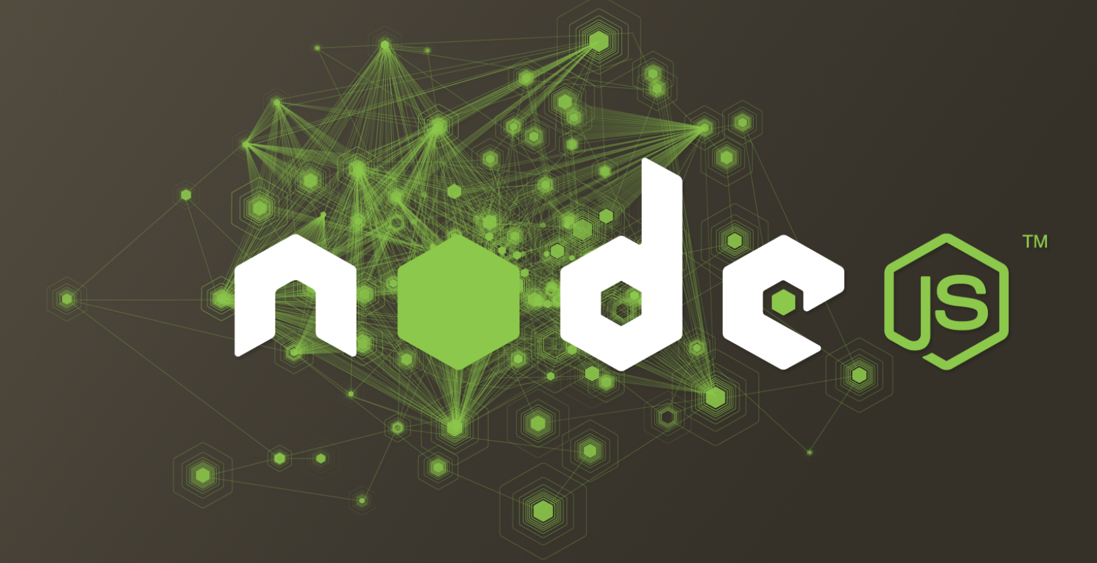

Apigee Edge – Overview of Capabilities
Developer Services
Developer Portal
Docs & Modeling
API Explorer
Monetization
API Team
Analytics Services
Developer Metrics
Ops Analytics
App Performance
App Usage
API Services
Backend
API Management
BaaS
Security
API Extensions

Slide 39
Apigee Edge – Overview of Capabilities
Developer Services
Developer Portal
Docs & Modeling
API Explorer
Monetization
API Team
Analytics Services
Developer Metrics
Ops Analytics
App Performance
App Usage
API Services
Backend
API Management
BaaS
Security
API Extensions

Slide 40

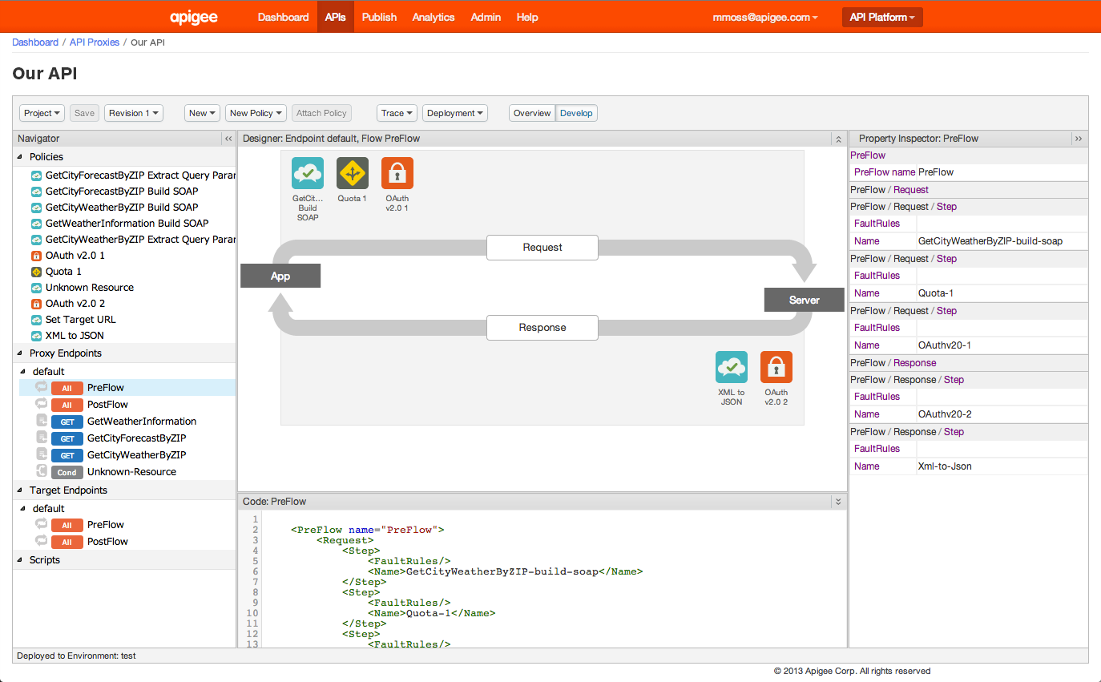
Create policies through configuration
Policies can be attached at different points and levels
>30 out of the box policies

Slide 41
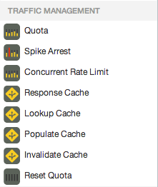
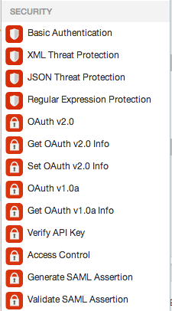
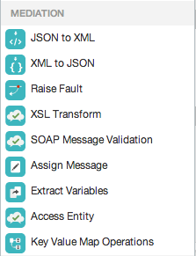
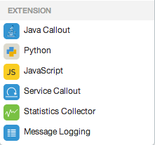
The Power of Policies
Manage interactions with API consumers and optimize performance
Secure APIs and protect back-end systems from attack
Transform, translate and reformat data for easy consumption
Extend with programming when you need it

Slide 42
Apigee Edge – Overview of Capabilities
Developer Services
Developer Portal
Docs & Modeling
API Explorer
Monetization
API Team
Analytics Services
Developer Metrics
Ops Analytics
App Performance
App Usage
API Services
Backend
API Management
BaaS
Security
API Extensions

Slide 43
Apigee Edge
Developer Services
Developer
Engage internal & external developers and monetize APIs
API Team
Analytics Services
Visibility from the app-end to the back-end
Business
User
API Services
Great APIs & apps fast
App
Backend
Notes:
Main Points:
Apigee Enterprise delivers the most comprehensive set of tools to support your Mobile Value Chain.
Script:
API Layer to securely transform backend services to easily consumable APIs to accelerate app development
Developer Layer to enable, engage and transact with your developer community (represented by the gray people graphics)
Data Layer to provide visibility from the app-end to the backend for business and technical teams

Slide 44
Fits with your deployment model: Cloud or on-premises
Cloud service
On-premises
Developer Services
Developer Services
Our Cloud
Analytics Services
Analytics Services
Your
Data Center or Cloud
API Services
API Services
Your
Data Center
or Cloud
Existing Backend
Existing Backend

Slide 45
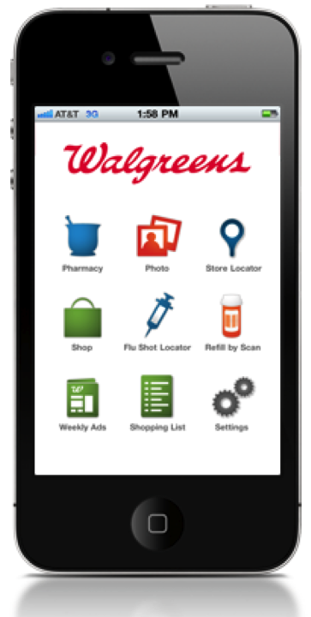





BaaS – Time to market for Apps & building engaging experiences
Get your developers creating right away!
Partner Services
Datastore
Pre-built
User Data
API Services
Connections/Social
Existing backend
Location queries
Push Notifications

Slide 46




Extend API Management through scripting
Customize the behavior of your APIs
Solve complex orchestration or mobile optimization problems by combining policies with a scriptable target endpoint
Host node.js apps in the Apigee cloud
Use thousands of third-party node.js modules in your APIs

Slide 47
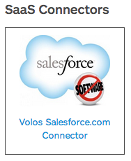
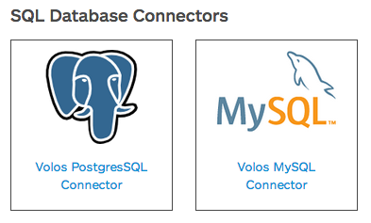
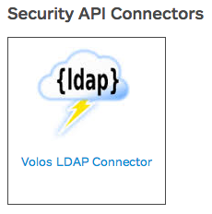
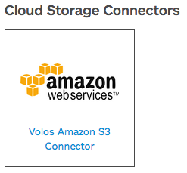
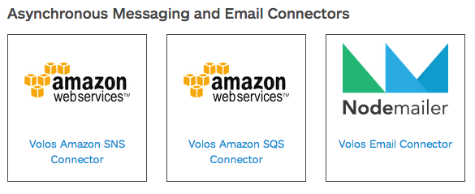
Nodejs Connectors

Slide 48
Apigee Edge – Overview of Capabilities
Developer Services
Developer Portal
Docs & Modeling
API Explorer
Monetization
API Team
Analytics Services
Developer Metrics
Ops Analytics
App Performance
App Usage
API Services
Backend
API Management
BaaS
Security
API Extensions

Slide 49

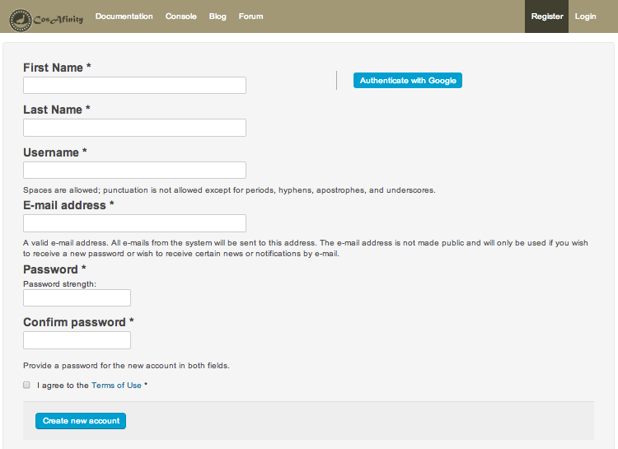
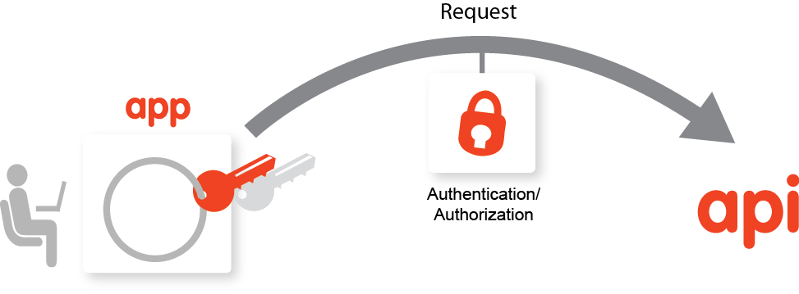
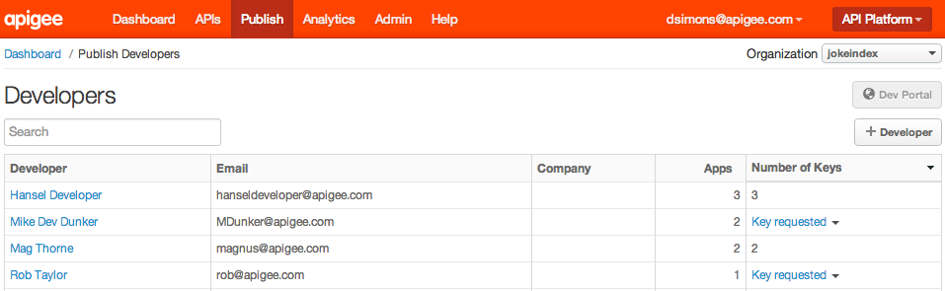
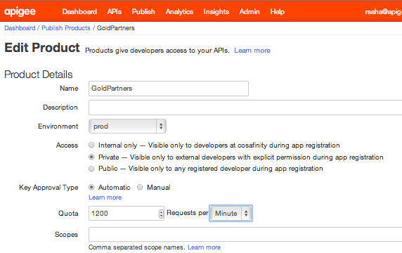
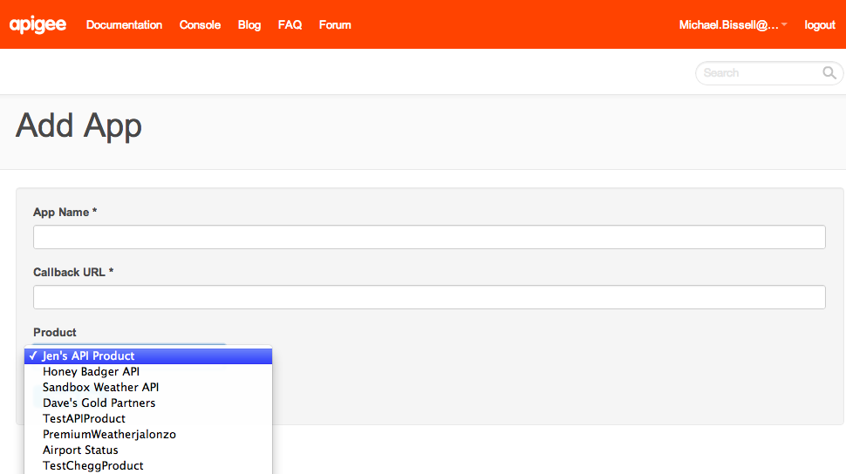
Self-service Developer Onboarding
Add App
Developer signs up and requests key
Manage key requests
Key approval designation
Developer ready to go

Slide 50
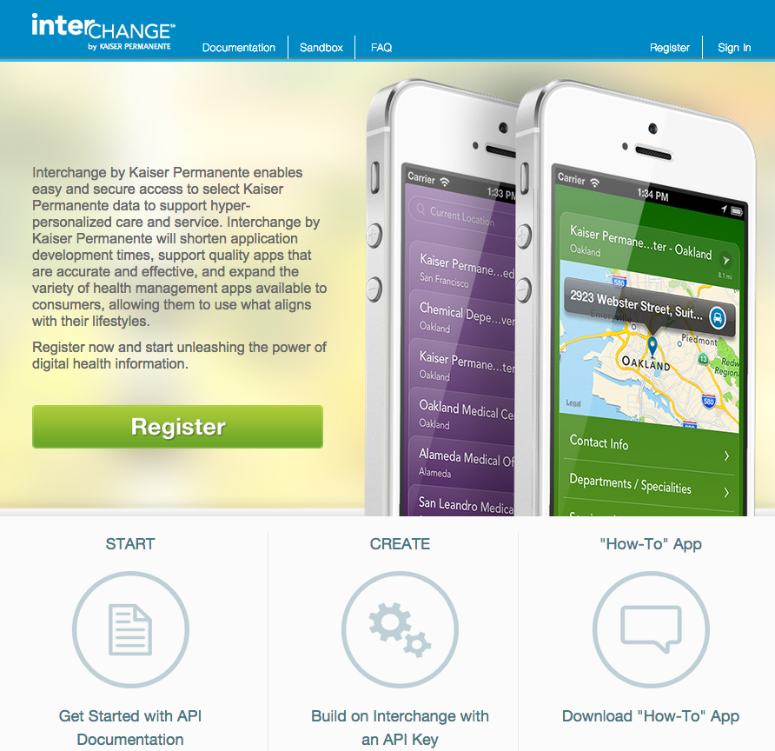
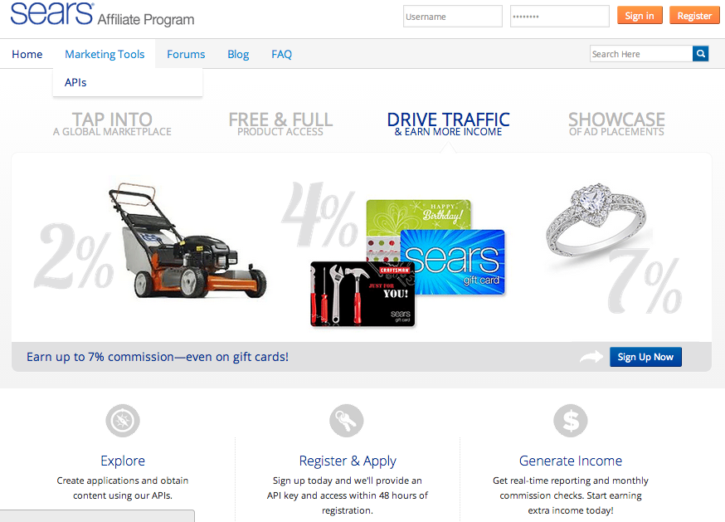
Create branded Developer Portals

Slide 51
Apigee Edge – Overview of Capabilities
Developer Services
Developer Portal
Docs & Modeling
API Explorer
Monetization
API Team
Analytics Services
Developer Metrics
Ops Analytics
App Performance
App Usage
API Services
Backend
API Management
BaaS
Security
API Extensions

Slide 52
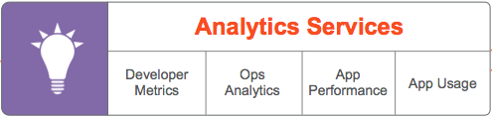
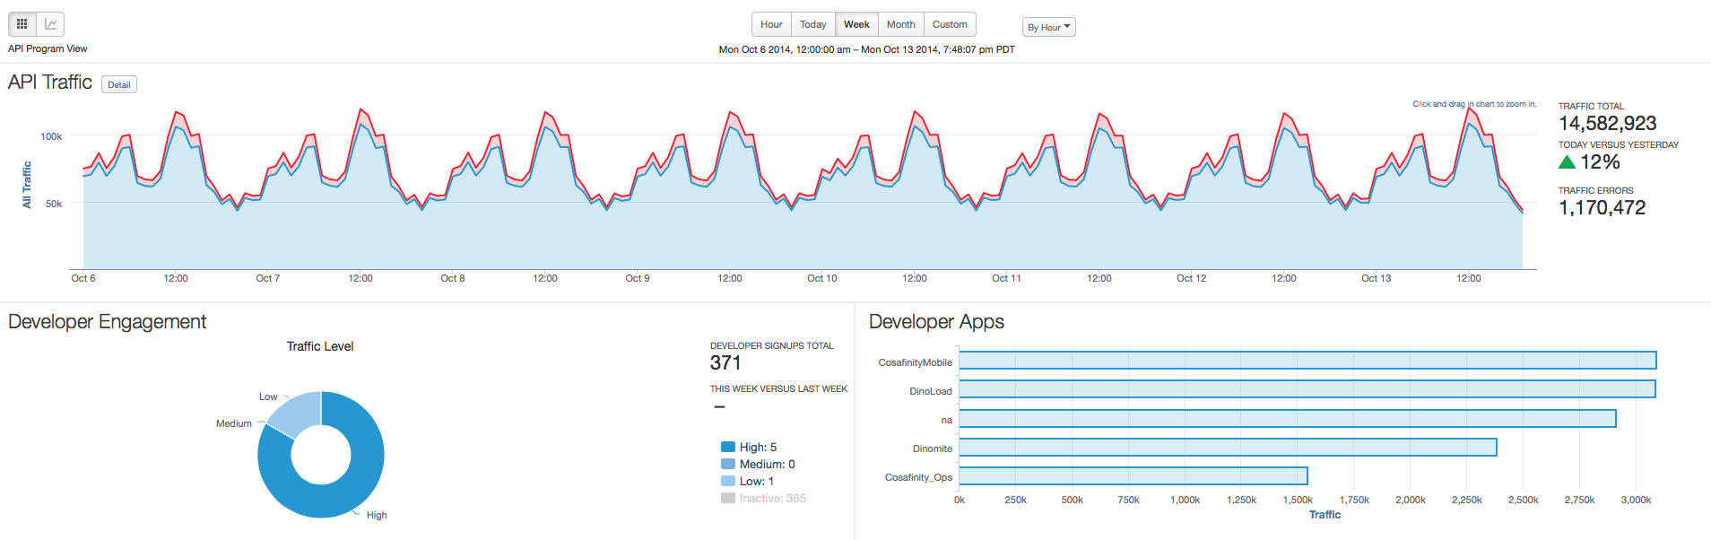
Analytics - End to end visibility

Slide 53
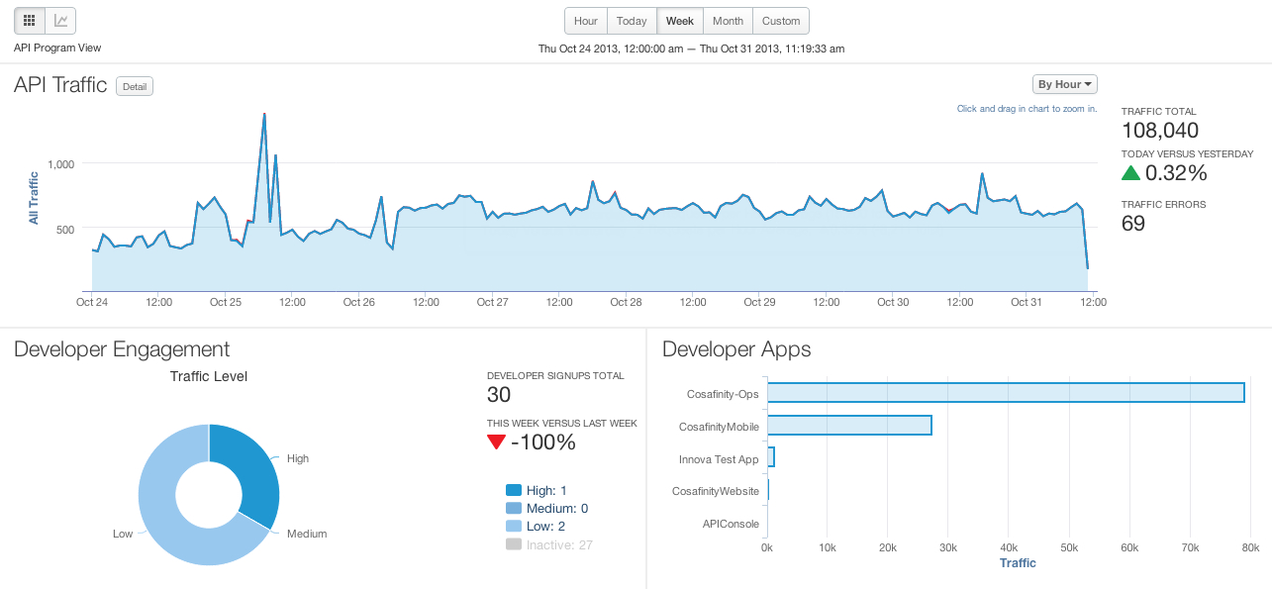
Self service delivers increased productivity for all
Analytics Services
Developer Services
API Services

Slide 54
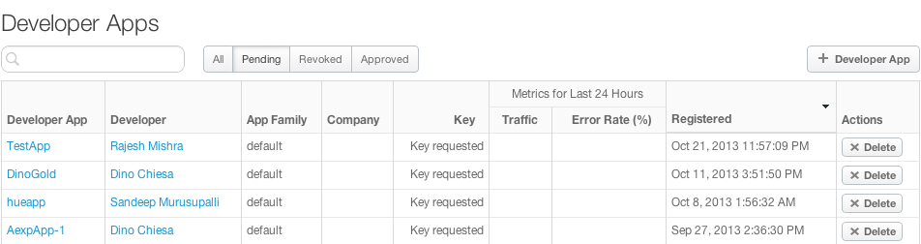
Self service delivers increased productivity for all
Analytics Services
Developer Services
API Services

Slide 55
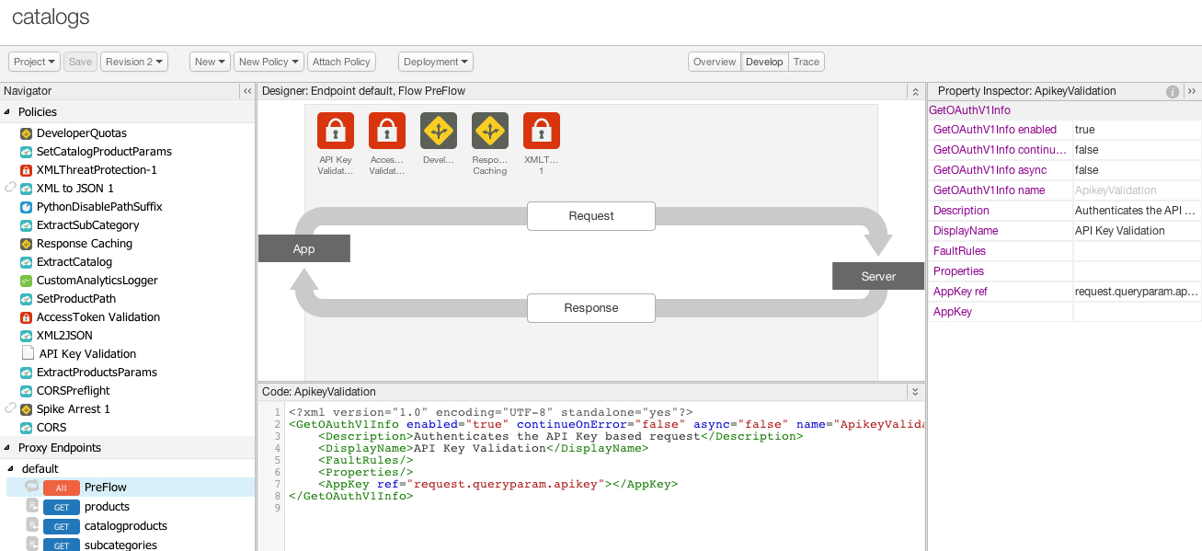
Self service delivers increased productivity for all
Analytics Services
Developer Services
API Services

Slide 56
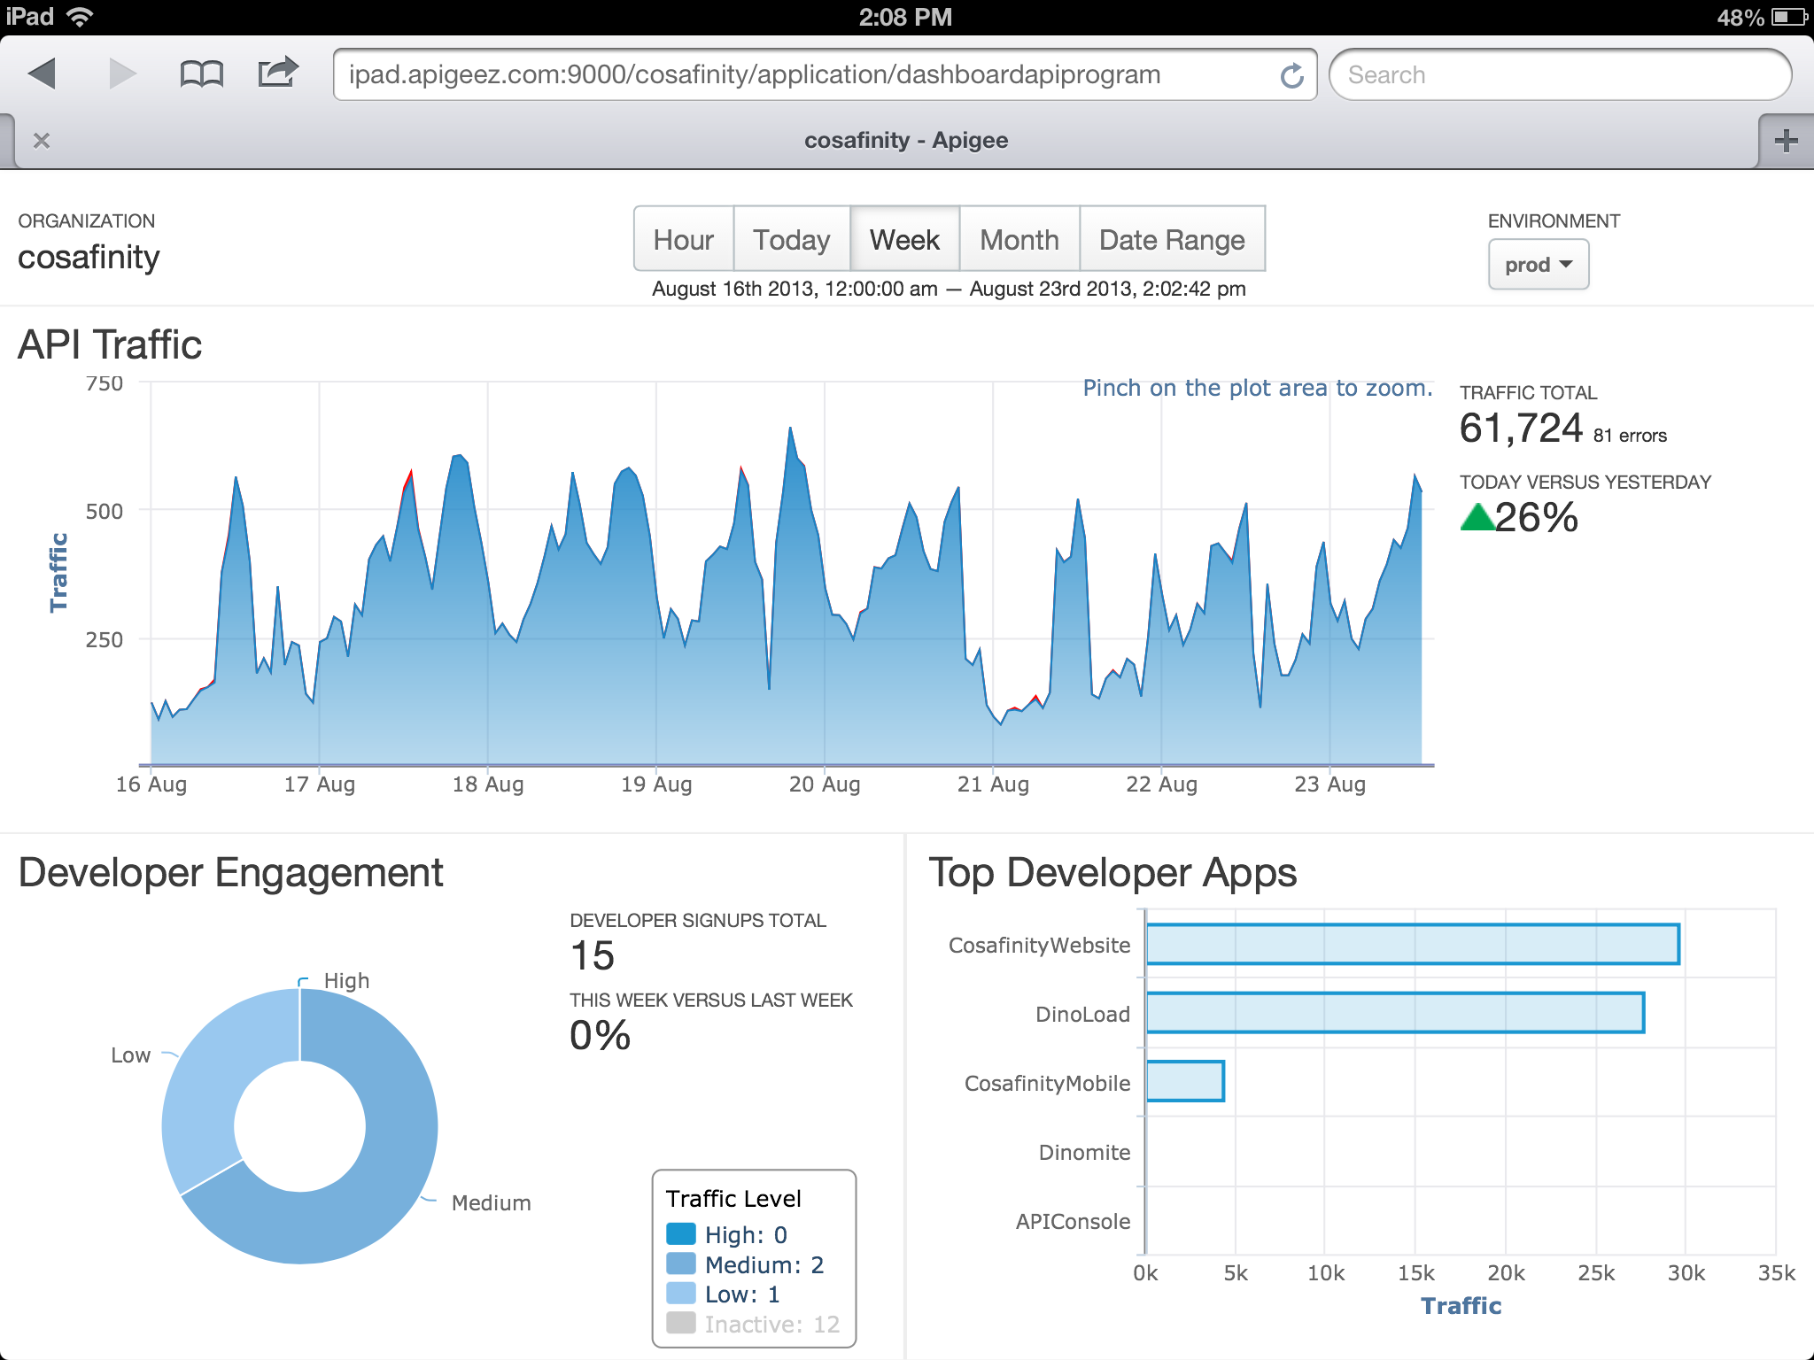
Self service delivers increased productivity for all
Analytics Services
Developer Services
API Services

Slide 57

World-class operations
Global presence
Worldwide network with carrier neutrality and latency optimization
Multi-continent redundancy and distribution network
Operations and support centers around the globe for cloud services and on-premises
True multi-tenancy and HA
Elastic capacity
5-tier Enterprise Cloud Architecture
Zero downtime API upgrades
Round-the-clock monitoring
Real-time and historic API health visibility
API security and compliance tracking
Component and process monitoring
Established
Planned

Slide 58
Apigee Edge
Built for the requirements of the digital economy
Apps, Data and APIs as foundational elements
Deploy in the Cloud or On-premises
Manage via Self Service
Global operations
Multi-region distribution network with true multi-tenancy and HA
Highly scalable, handling billions of API calls per day
Enterprise Security & Compliance: PCI, HIPAA, SOC 2
Unique set of capabilities resulting from customer focus
API Services that enable modern app functionality → great APIs & apps fast
End-to-end Analytics → visibility from the app-end to the back-end
Developer Services with Monetization → APIs delivering top line value

Slide 59






























Digital transformations powered by Apigee

Slide 60
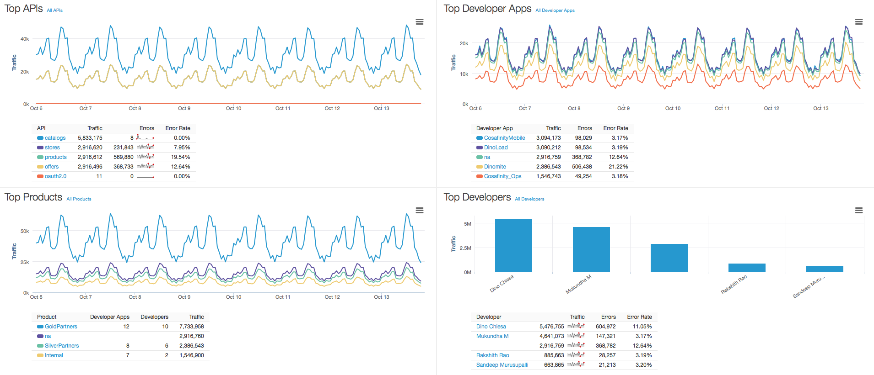
Top APIs, Developers, Apps, Products

Slide 61
Demonstration
Is the API program successful?
What tools can I use to develop APIs?
How are the APIs performing?
Product Manager
Dev Ops
API Developer
API

Slide 62

Demo Overview
API Services
API Proxies
Policies
Traffic
Security
Caching
Packaging
Products
BaaS
Analytics Services
Standard Reports
Custom Reports / Dashboards
Developer Services
Developer Portal
Smart Docs
Let’s take a look.

Slide 63
API Management Use Cases by Industry

Slide 64

Financial Services: Leading Payments Processor
Business Challenge
Solution
Result
Create an “easy to do business with” environment for partners
Establish a secure digital wallet for online purchases so personal financial data is not transmitted on the internet.
Provide a 360°view of the end user for member banks
Implement an API Management solution that provides:
An easy to use developer portal
Rapid assembly of new Restful APIs for online merchants
Extensive real-time analytics
Improved relationships with members and partners
Increased transaction volumes and revenue generation
Gained real-time views of buying behavior and accelerated the timing of new, targeted offers to buyers
Types of APIs
Example Apps
Coupon redemption
Payment options
Partner Loyalty Programs
Account status
Groupon: Daily Merchant coupons to help drive new customers
PayPal: Account linkage to banks, credit and debit cards
Tripit Point Tracker: aggregates points from various travel industry merchants.
Notes:
This is a use case that covers banks, payment processors, wireless telecommunications, merchants and their supply chain partners. Electronic wallets are getting significant airplay that falls in line with the growth of smart phones. Particularly with customers under 35, they rarely leave any location without taking their phone. Using phones for financial transactions using Near Field Communication (NFC) is growing and the pace will quicken in 2014. API Management provides a secure environment for transactions to take place and includes near real time analytics to understand what is going on with the transactions. To help generate new applications from internal, partner or independent developers, a branded, easy to use developer portal is included.
64

Slide 65
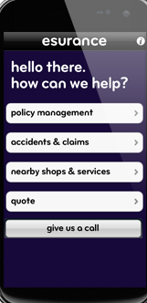

Insurance: Leading Property & Casualty Insurance Firm
Business Challenge
Solution
Result
Streamline claims processing for cost reduction.
Improve customer satisfaction by speeding up claim resolution.
Grow customer base.
Implement an API Management solution that provides:
Exposes customer policy information on mobile devices
Enable claims adjustors to include images of claim to verify damage estimate.
Include select repair partners to exchange data for fast resloution.
Eliminated paper based claims and reduced processing time by 3 days
Customers had the option of having the claim check direct deposited to their banking account.
Overall Customer Satisfaction rating improved significantly and then used as central marketing theme.
Types of APIs
Example Apps
Customer policy coverage access
Multimedia uploads to claim form
Repair estimate data exchange with select partners
Direct deposit banking approval
Google Maps: for directions once on the ground
Tripit: for aggregating travel information
Pizza Hut: food ordering and payment processing
Notes:
Most insurers are trying to find ways to streamline their claims processing and reduce their operational costs. By using APIs the insurance company can enable more effective self service options for its policy holders. Using mobile phones with cameras, GPS and a smart app, a motorist can take pictures of the car immediately after an accident, capture the image of the other drivers license and insurance information, initiate a claim form include the associated the GPS coordinates along with the images of the scene. Additionally, a tow truck could be summoned as well as a taxi or rental car. All done with a set of APIs and a new business process. API Management provides a secure environment for transactions to take place and includes near real time analytics to understand what is going on with the transactions. To help generate new applications from internal, partner or independent developers, a branded, easy to use developer portal is included.
65

Slide 66
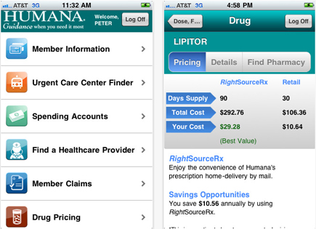
Healthcare: Leading Healthcare Provider
Business Challenge
Solution
Result
Allow patients, physicians and medical personnel secure multi-channel access to patient data including:
Appointments
Insurance coverage
Prescription refills
Patient/physician email
Implement an API Management solution that provides:
A secure/encrypted environment for maintaining and transmitting sensitive patient data
An easy to use developer portal
Rapid assembly of new APIs to access legacy applications without extensive app rewrite.
Released new REST enabled applications for mobile devices in under 90 days.
Created reusable APIs for pretreatment authorization from multiple insurance carriers
Provided patients a mobile app to refill prescriptions via mobile devices.
Types of APIs
Example Apps
Appointment book access
Insurance coverage requests
Pharmacy order entry
Secure messaging/email
Merck Medicus: Patient handouts
Greenway PrimeMOBILE: Electronic Health Record access
BC/BS NC: HealthNAV, provides an urgent care finder
WellDoc Diabetes Manager: connecting patient readings with physicians
Notes:
Managing healthcare data today requires strict adherence to a large and growing number of regulations while at the same time dealing with reduced fees from insurers, Medicare/Medicaid (or other governmental agency) and increasing costs of equipment, training and personnel. With APIs, healthcare professionals can exchange critical patient data to reduce the time for diagnosis, treatment and rehabilitation. API Management provides a secure and encrypted capability to protect sensitive patient data, and ensures it is consumed by only authorized personnel. Connections to pharmacies, testing centers and therapy facilities are handled by the APIs to provide a seamless environment to improve patient care and control costs.
66

Slide 67

Energy & Utilities: Leading Electric Utility
Business Challenge
Solution
Result
Improve the efficiency of energy consumption across consumer, commercial and industrial customers.
Increase utilization of self-service portal to reduce operational costs
Reduce power outage time caused by extraordinary events.
Implement an API Management solution that provides:
A secure/encrypted environment for transmitting usage data to demand systems and models.
An easy to use developer portal
Extensive real-time analytics to better understand customer behavior and payment patterns
Launched multichannel app to monitor and control energy usage
Increased use o self-service portal by 15% resulting in operational cost savings of 3%
Improved response and power restoration time by mashing up location data of repair teams and outage failure point.
Types of APIs
Example Apps
Energy consumption & management
Service requests including new service, repair, and rate management
Location services for mobile repair teams
Inventory management for field repair depots and teams
MobileIron SmartHome: remote control of home electrical devices
Southern California Edison: customer support for service transfer.
Scottish Power XDA repair centre.
Notes:
Energy usage and costs continue to increase for all types of customers. Finding ways to better manage the available power and restore it following an outage can lead to lower consumption and monthly bills as well as improved customer service when get the lights turned on again. Providing a mobile smart app to control heating and cooling systems in homes, commercial and industrial buildings can enable users to manage their usage and take advantage of lower prices during off peak periods. Also for repair crews, having apps that give precise GPS coordinates for power outages, and better control of “in the field” inventory of repair parts, can speed the best equipped repair team to the site and restore the power more quickly. API Management provides a secure environment for transactions to take place and includes near real time analytics to understand what is going on with the transactions. To help generate new applications from internal, partner or independent developers, a branded, easy to use developer portal is included.
67

Slide 68


Automotive: Leading Automobile Manufacturer
Business Challenge
Solution
Result
Create additional sticky services for auto owners
Expand the ecosystem for dealers and partners including road service and hospitality brands.
Generate higher dealer traffic volume
Implement an API Management solution that provides:
A secure messaging environment between the auto manufacturer and the partners.
An easy to use developer portal
Extensive real-time analytics to better understand customer behavior and usage patterns
Launched new service utilizing sensor data from the car, GPS coordinates and roadside service stations to minimize breakdowns and locate nearby repair facilities.
Generated multiple customer testimonials that helped increase dealer traffic by 8%
Types of APIs
Example Apps
Location based services
Sensor data to warranty systems
Alerts to dealers
Service record access
Google Maps: GPS location mapping
GM OnStar: vehicle diagnostics online monitoring while you drive
BMW Connected Drive: intelligent emergency call for assistance
Notes:
In today’s automobiles is not uncommon to find 4,000 sensors capturing data to feed the onboard processing elements. GPS devices are now standard in most new cars and with onboard wireless technologies, the vehicles of today are rolling computers with robust communications capabilities. When coupled with other data sources providing weather, road congestion and emergency response vehicles, the APIs providing easy access to this information can provide drivers with near real time data to shorten their commute, avoid accident sites or even report a problem as it is happening. The API Mgt. system protects against denial of service attacks, routes key messages to the appropriate destination, manages the message flow so the backend systems are not overloaded and monitors the effectiveness of the system to ensure compliance with SLAs.
68

Slide 69

Telecom: Leading Wireless Carrier
Business Challenge
Solution
Result
Establish a secure digital wallet for subscribers
Create ecosystem for Near Field Communication (NFC) transactions including banks and merchants
Leverage existing loyalty programs
Implement an API Management solution that provides:
An easy to use developer portal
Rapid assembly of new Restful APIs for merchants to access transaction data
Extensive real-time analytics to better understand customer behavior
Launched new service with “sticky” application generating more ARPU
Gained a closer relationship with subscribers and merchants
Provided real-time views of buying behavior and accelerated the timing of new, targeted offers to buyers via loyalty programs
Types of APIs
Example Apps
Payment options (credit/debit)
Partner Loyalty Programs
Merchant specific promotions
Access to payment account information
Groupon: Daily Merchant coupons to help drive new customers
PayPal: Account linkage to banks, credit and debit cards
Tripit Point Tracker: aggregates points from various travel industry merchants.
Notes:
This is a use case that covers banks, payment processors, wireless telecommunications, merchants and their supply chain partners. Electronic wallets are getting significant airplay that falls in line with the growth of smart phones. Particularly with customers under 35, they rarely leave any location without taking their phone. Using it for financial transactions using Near Field Communication (NFC) is growing and the pace will quicken in 2014. API Management provides a secure environment for transactions to take place and includes near real time analytics to understand what is going on with the transactions. To help generate new applications from internal, partner or independent developers, a branded, easy to use developer portal is included.
69

Slide 70


Media & Entertainment: Leading Movie Producer
Business Challenge
Solution
Result
Manage partner ecosystem leading up to major a movie release
Control ticket distribution for selected premier venues
Effectively manage IT infrastructure for cyclical demand loads
Implement an API Management solution that provides:
An easy to use and access developer portal for partners
Traffic management to control demand for access to ticket outlets
Scalable cloud based infrastructure to meet demand
Launched new developer portal for partners to add tie in promotions for new movie releases
Smoothed message traffic and incorporated a tiered access program for high value customers
Augmented an on premise implementation with on-demand cloud expansion as needed.
Types of APIs
Example Apps
Ticket purchase
Product placement promotions
Access to sound track recordings
Tiered access (i.e. gold, silver, bronze etc.)
Moviefone pre-release ticket ordering
ComingSoon.net: movie trailers and latest news on stars
Sony Pictures Brand Placement on YouTube, webpages etc.
Notes:
Blockbuster movies, games, and concerts generate significant interest from consumers and the key players on the producer side are looking for a major return on their investment. APIs can help provide access to seat inventory, special ticket promotions, early access to new games/programs etc. They can also provide the tie-ins for loyalty programs as well as product placement promotions. Connecting partner assets/programs helps all these players generate new revenue streams, improved customer satisfaction and more intense loyalty alignment. API Management provides a secure environment for transactions to take place and includes near real time analytics to understand what is going on with the transactions. To help generate new applications from internal, partner or independent developers, a branded, easy to use developer portal is included.
70

Slide 71

Banking: Leading Commercial Bank
Business Challenge
Solution
Result
Establish a secure digital wallet for consumer banking customers
Create ecosystem for partners including global credit card companies and merchants
Leverage international brand loyalty programs
Implement an API Management solution that provides:
A secure/encrypted environment for maintaining and transmitting sensitive card holder data
An easy to use developer portal
Extensive real-time analytics to better understand customer behavior and payment patterns
Launched new service maintaining multiple payment options
Increased use and revenue from branded debit and credit cards
Provided real-time views of buying behavior and accelerated the timing of new, targeted offers to buyers via bank and merchant loyalty programs
Types of APIs
Example Apps
Payment options (credit/debit)
Partner Loyalty Programs
Bank and merchant specific promotions
Access to banking account information
PayPal: Account linkage to banks, credit and debit cards
Tripit Point Tracker: aggregates points from various travel industry loyalty programs.
PasKey Mobile banking (Monte Dei Pashi Di Siena) account access.
Notes:
This is a use case that covers banks, payment processors, wireless telecommunications, merchants and their supply chain partners. Electronic wallets are getting significant airplay that falls in line with the growth of smart phones. Particularly with customers under 35, they rarely leave any location without taking their phone. Using it for financial transactions using Near Field Communication (NFC) is growing and the pace will quicken in 2014. API Management provides a secure environment for transactions to take place and includes near real time analytics to understand what is going on with the transactions. To help generate new applications from internal, partner or independent developers, a branded, easy to use developer portal is included.
71

Slide 72
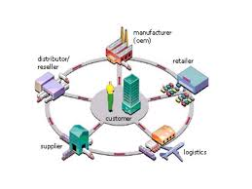
Aerospace & Defense: Supply Chain
Business Challenge
Solution
Result
Streamline procurement process when on-boarding new trading partners
Minimize reliance on VANs (Value Added Networks) to reduce costs
Maintain accurate real-time location and inventory usage data.
Implement an API Management solution that provides:
A secure/encrypted environment for maintaining and transmitting sensitive purchasing data
An easy to use developer portal
Extensive real-time analytics to better understand location and usage patterns
Eliminated need for sending and receiving purchase order and invoice documents for new vendors
Provided catalog access and “shopping cart” order process
Generated extensive analytics tracking individual products for location, shelf life and consumption statistics.
Types of APIs
Example Apps
Payment options
Catalog/inventory availability
RFID location based services
Shopping cart services
Tiered access
Amazon shopping cart
IBM® Emptoris® for supplier on-boarding and qualification
PINC Solutions Real Time Location Systems for GPS enabled RFID asset tracking
Notes:
For the past 30+ years, organizations have been looking to technology to streamline their supply chain process, reduce delivery times and lower their cost of goods and services. API Management is a key enabler to help achieve these objectives by making organizations easy to do business with. Eliminating many of the proprietary environments in place (VANs, Hubs, special e-commerce connections and protocols), API Management facilitate easy on-boarding of new trading partners, smoothing and monitoring of the traffic, and can provide deeper analytics in near real time which can translate into better decision making.
72

Slide 73

Retail: Leading Electronics Retailer
Business Challenge
Solution
Result
High cost of sale due to reliance on retail stores
No participation in external, web-based /mobile markets
Limited access to customers in locations without store-fronts
Publish APIs targeting content aggregation providers
Increased revenue via participation in external markets
Increased profitability by closing under-performing stores
Established differentiation in external markets by providing same day fulfillment (via storefronts)
Types of APIs
Example Apps
Product catalog
Price list
Inventory by location
Store location
C-Net: Content aggregation for electronics reviews/pricing
Amazon: Electronic store-front
ShopSavvy: Mobile app for price-comparison
Notes:
For small retail organizations, it is often easier to align themselves with a large aggregator such as Amazon or C-Net for order fulfillment rather than adding an e-commerce site to their web presence. The pull of Amazon eliminates the need to attract shoppers to a small, unknown shop in anytown USA. By implementing the API Management solution, an aggregator can expose inventory and pricing information from it fulfillment partners, connect to payment providers and add shipment tracking capabilities allowing the customer an easy to use method of shopping on line.
73

Slide 74

Government: Business License Bureau
Business Challenge
Solution
Result
Create a multi-channel business license application process
Reduce the steps and shorten the time process the application
Ensure license renewals are executed on time.
Implement an API Management solution that provides:
A secure/encrypted environment for maintaining and transmitting sensitive applicant data
An easy to use developer portal for accessing legacy systems during the approval process
Analytics for measuring usage
Launched new license application portal that automatically populated forms during the approval process
Automated the insurance verification process required for license issuance
Reduced the time to process by 15% and minimized applicant clerical data input by 45%
Types of APIs
Example Apps
Access to variety of legacy systems inlcuding:
Building permits
Food and liquor licenses
Neighborhood variances
Fire inspections
Property and casualty insurance verification
Chicago Business Affairs: License application and zoning guide
New York City Restoration Permits: post Hurricane Sandy rebuilding
Slate.com link to TerraEarth observatory showing Moore, OK after EF5 tornado
Notes:
Governments at all levels are trying to provide more services, with fewer human resources and less budget across the board. To bridge this widening gap, many organizations are providing more self service capabilities to improve the quality, reduce the manual steps and decrease the time necessary to meet the citizen’s needs. APIs enable a multi-channel access to these services, connect multiple partners and counter parties in an environment that invites developers to extend the limited internal resources of many government entities. Access to open data (i.e. weather, info from other government organizations) is another major initiative that government clients are looking to leverage. API Management provides a secure environment for transactions to take place and includes near real time analytics to understand what is going on with the transactions. To help generate new applications from internal, partner or independent developers, a branded, easy to use developer portal is included.
74

Slide 75
Take it for a spin today!
Apigee Developer

Slide 76
Apigee Products
Apigee Edge
Powering digital transformations with APIs, developer services, and end-to-end analytics
Apigee Insights
Optimize your digital business with insights from contextual analysis of app and API data

Slide 77



Insights: Context driven actions
Action
External Context
Social and other data
Apigee Insights
Internal Context
CRM and other data
All Digital Channels
App Analytics
Apigee Edge
Developer Analytics
Data
API Analytics

Slide 78
Apigee Products
Apigee Exchange
Industry focused API networks for app interoperability
Apigee Insights
Optimize your digital business with insights from contextual analysis of app and API data
Apigee Edge
Powering digital transformations with APIs, developer services, and end-to-end analytics

Slide 79

Apigee Exchange: Solving for fragmentation of digital ecosystems in multiple industries
Apigee Exchange powers industry-wide digital ecosystems
Users
Apps
Developers
API Providers

Slide 80


Apigee Digital Business Platform
Insights
Big Data
Mobile
ESB, SOA,
App Servers,
Databases
Point of Sale
Edge
Apps, APIs, Analytics
Partner
Web
Backend Services
Apps
Exchange
API Networks

Slide 81
Understanding APIs and API proxies
Apigee Edge lets you easily and quickly build RESTful APIs that can be consumed by app developers.
You expose APIs on Edge by building API proxies that act as managed 'facades' for backend services.

Slide 82
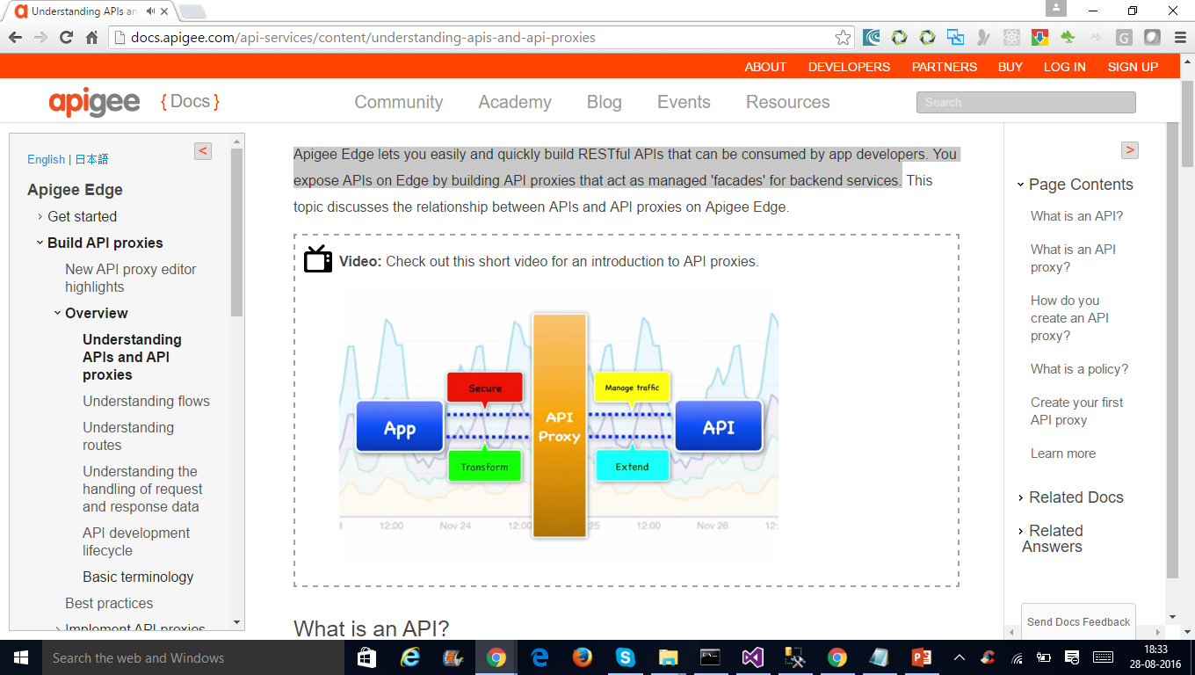
Understanding APIs and API proxies

Slide 83
What is an API?
An API is an architecture that makes it easy for one application to 'consume' capabilities or data from another application.
By defining stable, simplified entry points to application logic and data, APIs enable developers to easily access and reuse application logic built by other developers.
In the case of 'Web APIs', that logic and data is exposed over the network.

Slide 84
What is an API?
Since applications that consume APIs are sensitive to changes, APIs also imply a 'contract'.
The contract provides some level of assurance that, over time, the API will change in a predictable manner.
Apigee Edge enables you to build APIs and if you have APIs already, expose them directly, while adding a management and visibility layer.
If you have HTTP enabled services, such as SOA-based Web services, they can also be exposed as APIs via Apigee Edge.

Slide 85
What is an API Proxy?
You expose APIs on Apigee Edge by implementing API proxies.
API proxies decouple the app-facing API from your backend services, shielding those apps from backend code changes.
As you make backend changes to your services, apps continue to call the same API without any interruption.

Slide 86
What is a policy?
Edge enables you to control API behavior without writing any code by using policies.
A policy is like a module that implements a specific, limited management function as part of the proxy request/response flow.

Slide 87
What is a policy?
Policies are designed to let you add common types of management capabilities to an API easily and reliably.
Policies provide features like security, rate-limiting, transformation, and mediation capabilities, saving you from having to code and maintain this functionality on your own.

Slide 88
API proxy configuration
ProxyEndpoint:
Defines the way client apps consume your APIs.
You configure the ProxyEndpoint to define the URL of your API proxy.
The proxy endpoint also determines whether apps access the API proxy over HTTP or HTTPS.
You usually attach policies to the ProxyEndpoint to enforce security, quota checks, and other types of access control and rate-limiting.

Slide 89
API proxy configuration
TargetEndpoint:
Defines the way the API proxy interacts with your backend services.
You configure the TargetEndpoint to forward requests to the proper backend service, including defining any security settings, HTTP or HTTPS protocol, and other connection information.
You can attach policies to the TargetEndpoint to ensure that response messages are properly formatted for the app that made the initial request.

Slide 90
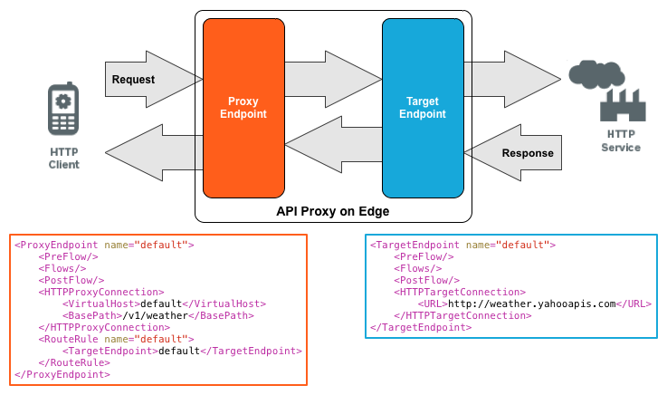

Slide 91
Deploying a standalone Node.js app
npm install -g apigeetool
$ apigeetool deploynodeapp -n {A name for your new proxy} -d {The root directory of your Node.js app} -m {The name of the main Node.js file} -o {Your org name on Edge} -e {The environment to deploy to} -b {The base URL for your proxy} -u {Your Edge email address} -p {Your Edge password}

Slide 92
Deploying a standalone Node.js app
$ apigeetool deploynodeapp -n myNodeApp -d . -m server.js -o myorg -e test -b /myNodeApp -u ntesla -p myPassword
apigeetool deploynodeapp -n myfirstNodeApp -d . -m MessageServer.js -o iiht -e test -b /myNodeApp -u eswaribala@rediffmail.com -p xxxxxxxx!

Slide 93
Deploying a standalone Node.js app
Importing new application myNodeApp Imported new app revision 1 Deploying revision 1 Deployed. Proxy: "myNodeApp" Revision 1 Environment: test BasePath: /myNodeApp Status: deployed

Slide 94
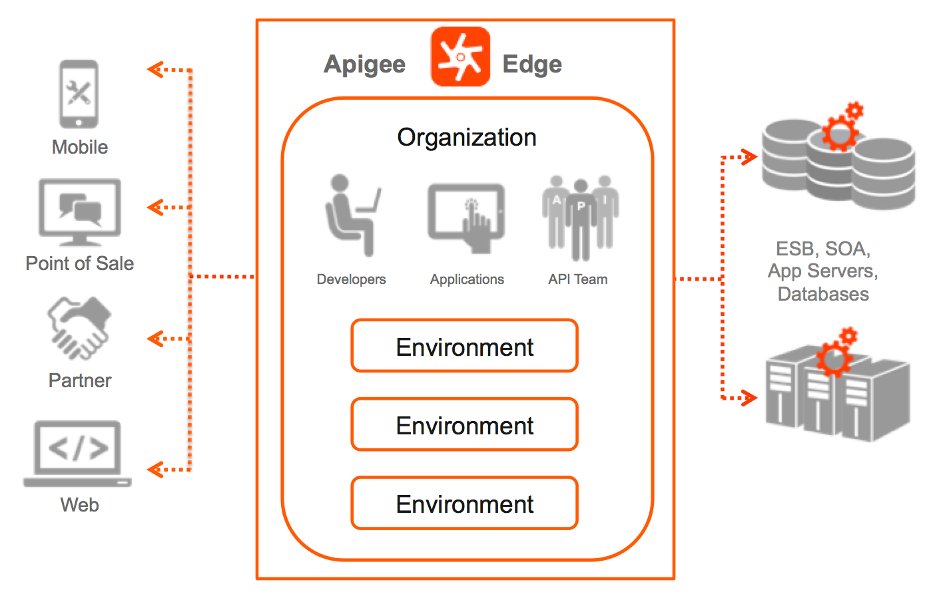

Slide 95
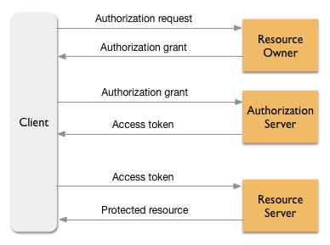
OAuth2.0

Slide 96
Questions

